Slide 1
IEEE Central Texas Section
Fall Planning Meeting
September 16th, 2017
San Marcos, TX

Slide 2
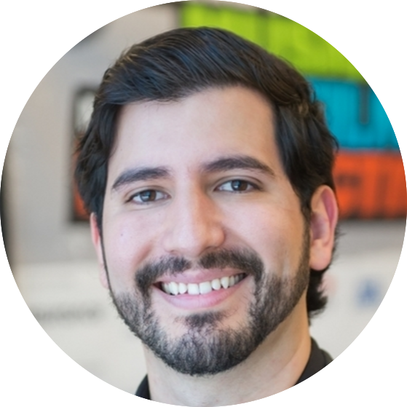
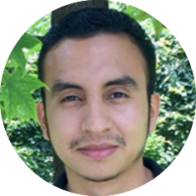
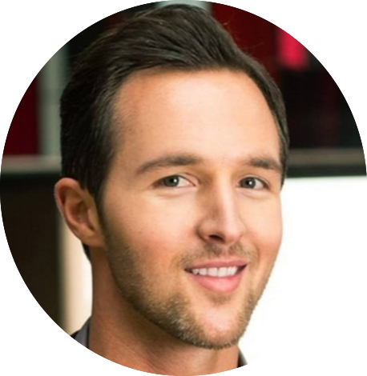
Leadership Team
Fabio Gomez
- Chair
Jose Lacavex
- Austin Chair
Gerardo Arias
- San Antonio Chair
Devon Ryan
- Past Chair
Notes:
Add member photos here

Slide 3
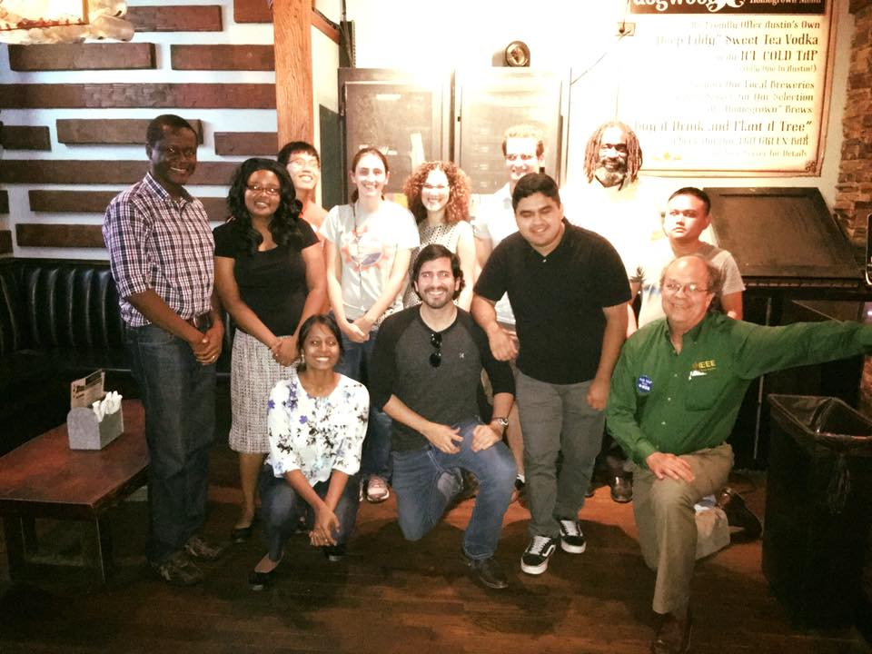
Notes:
Maybe create a slide for each bullet and add one photo
SXSW
Great networking and advertising for future events
FLF
It was a great (rather long) event
Definitely inspirational for young audience
It was good to bring industry veterans to show accomplishments and life in IEEE
It was also great to bring young successful Members to share their more relatable knowledge/experience with the young
Creative networking event that forced people to interact with each other. Made a lot of friends that way
Successful IEEE N3XT in Austin. Over 150 attendees
Strong Young Professionals and Student presence
It had 3 tracks. It was short and sweet
Had a Young Professionals reception right after, which was packed
Drove membership and volunteering opportunities
Lots of students
Started Monthly Networking events
About 15-20 attendees
They all liked the event!
They came to discover volunteering and networking opportunities
They liked the format and the time (Tuesday evening)
Gonna try new sponsors for every monthly event to keep things fresh
To attract newcomers and retain existing audience
Takeaways
To come prepared with contacts amongst other societies for networking
To come prepared with events they can volunteer for
To come prepared with flyers/cards for all the above

Slide 4
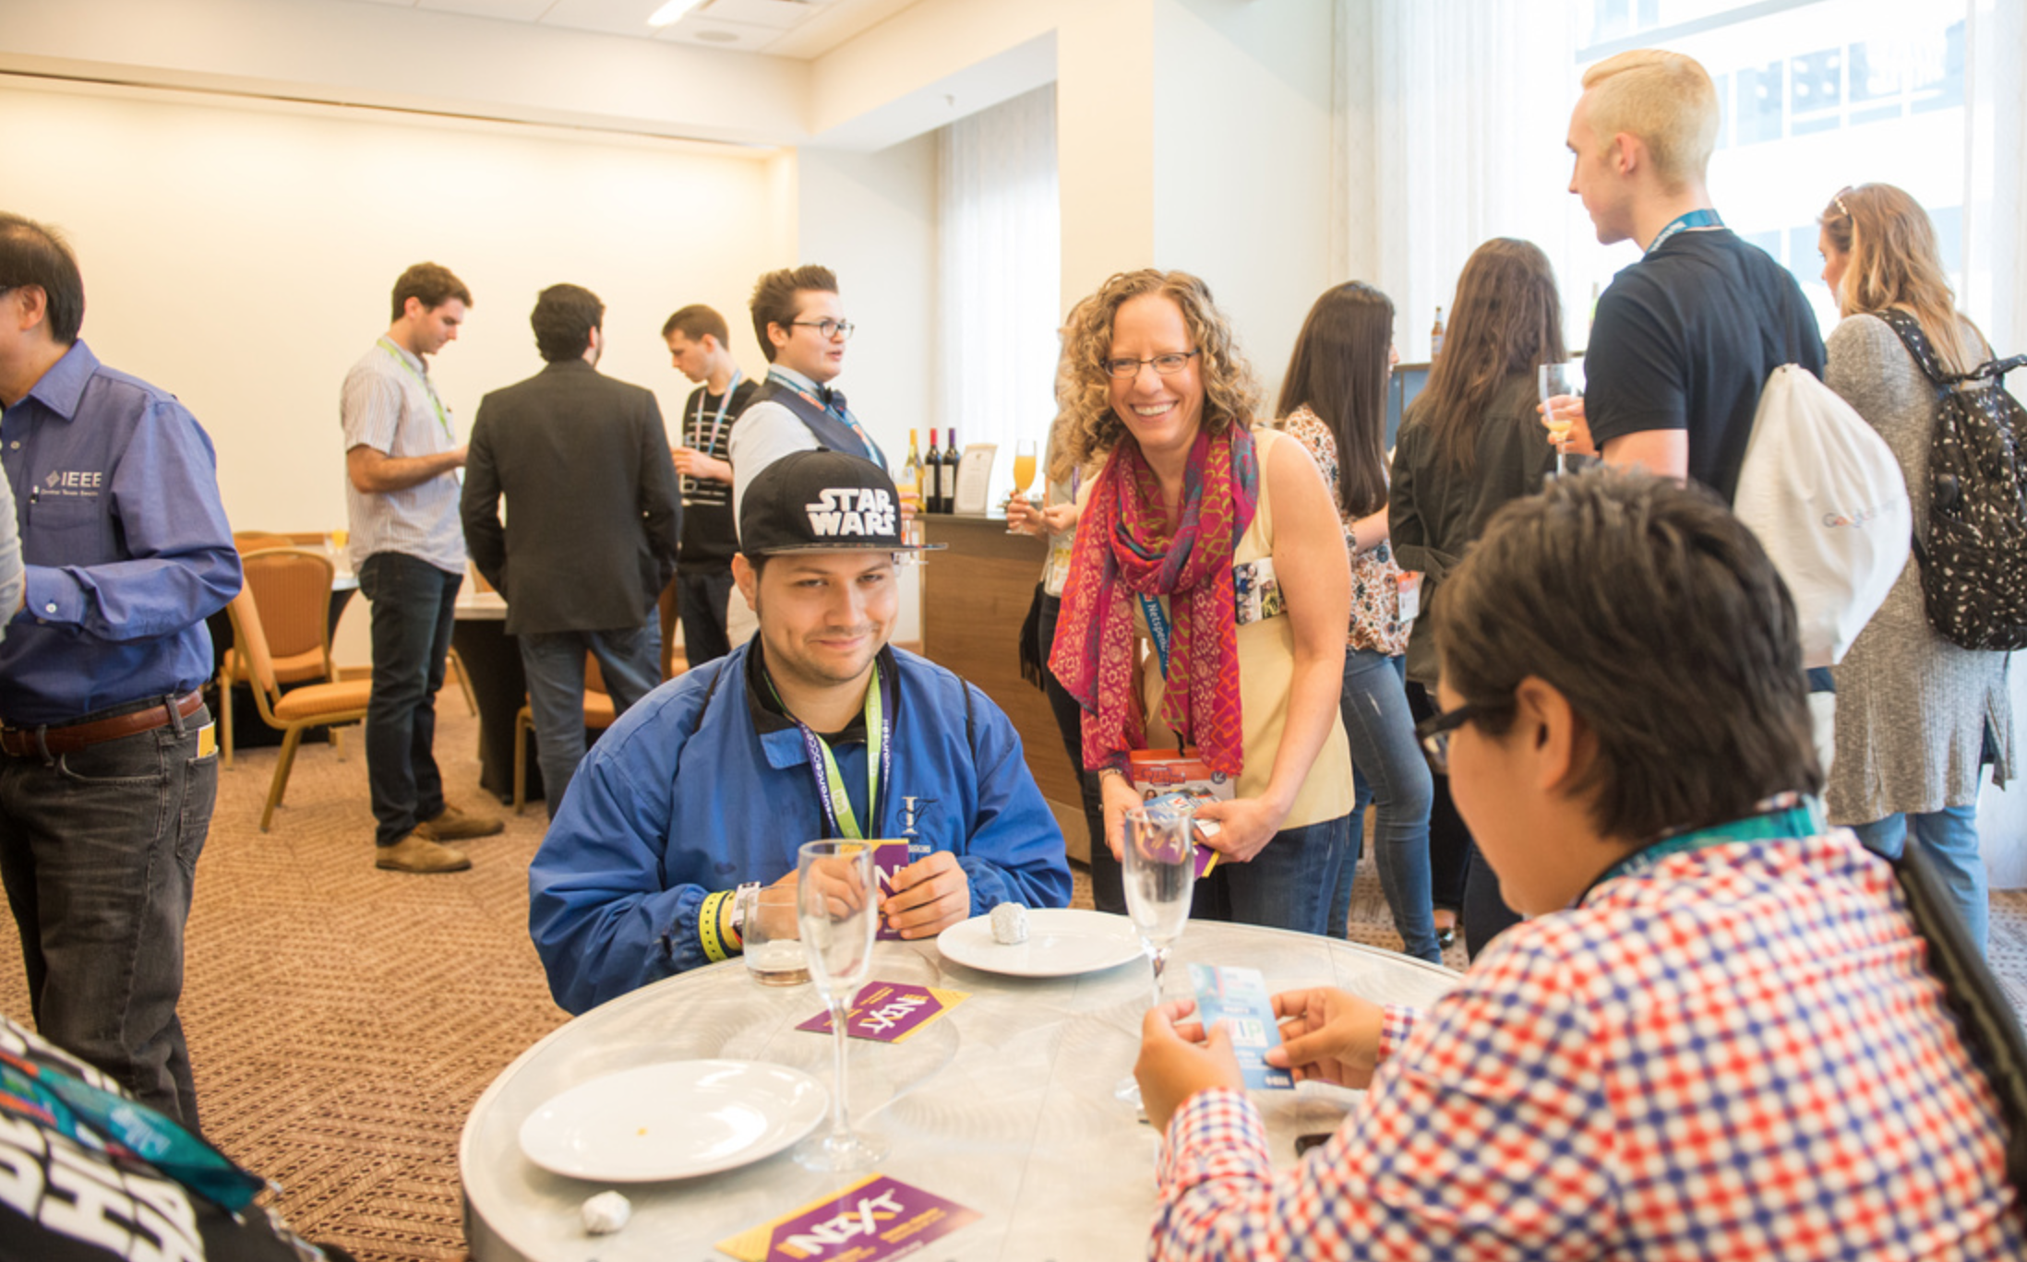
Notes:
Maybe create a slide for each bullet and add one photo
SXSW
Great networking and advertising for future events
FLF
It was a great (rather long) event
Definitely inspirational for young audience
It was good to bring industry veterans to show accomplishments and life in IEEE
It was also great to bring young successful Members to share their more relatable knowledge/experience with the young
Creative networking event that forced people to interact with each other. Made a lot of friends that way
Successful IEEE N3XT in Austin. Over 150 attendees
Strong Young Professionals and Student presence
It had 3 tracks. It was short and sweet
Had a Young Professionals reception right after, which was packed
Drove membership and volunteering opportunities
Lots of students
Started Monthly Networking events
About 15-20 attendees
They all liked the event!
They came to discover volunteering and networking opportunities
They liked the format and the time (Tuesday evening)
Gonna try new sponsors for every monthly event to keep things fresh
To attract newcomers and retain existing audience
Takeaways
To come prepared with contacts amongst other societies for networking
To come prepared with events they can volunteer for
To come prepared with flyers/cards for all the above

Slide 5
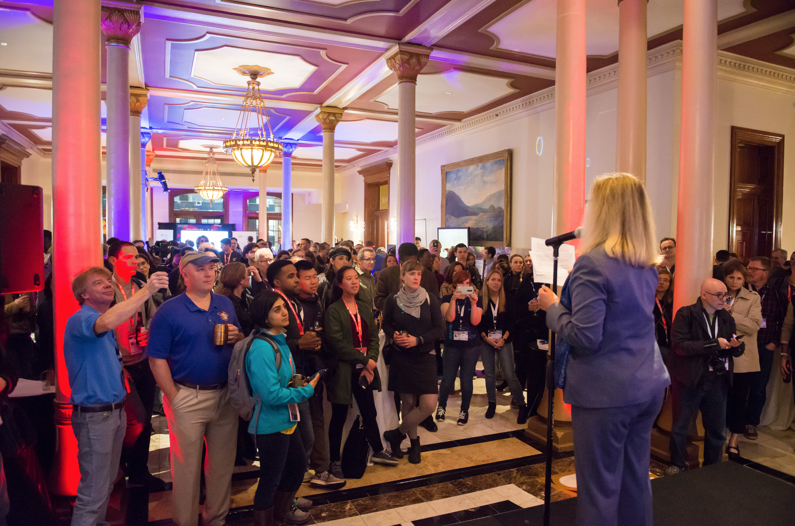
Notes:
Maybe create a slide for each bullet and add one photo
SXSW
Great networking and advertising for future events
FLF
It was a great (rather long) event
Definitely inspirational for young audience
It was good to bring industry veterans to show accomplishments and life in IEEE
It was also great to bring young successful Members to share their more relatable knowledge/experience with the young
Creative networking event that forced people to interact with each other. Made a lot of friends that way
Successful IEEE N3XT in Austin. Over 150 attendees
Strong Young Professionals and Student presence
It had 3 tracks. It was short and sweet
Had a Young Professionals reception right after, which was packed
Drove membership and volunteering opportunities
Lots of students
Started Monthly Networking events
About 15-20 attendees
They all liked the event!
They came to discover volunteering and networking opportunities
They liked the format and the time (Tuesday evening)
Gonna try new sponsors for every monthly event to keep things fresh
To attract newcomers and retain existing audience
Takeaways
To come prepared with contacts amongst other societies for networking
To come prepared with events they can volunteer for
To come prepared with flyers/cards for all the above

Slide 6
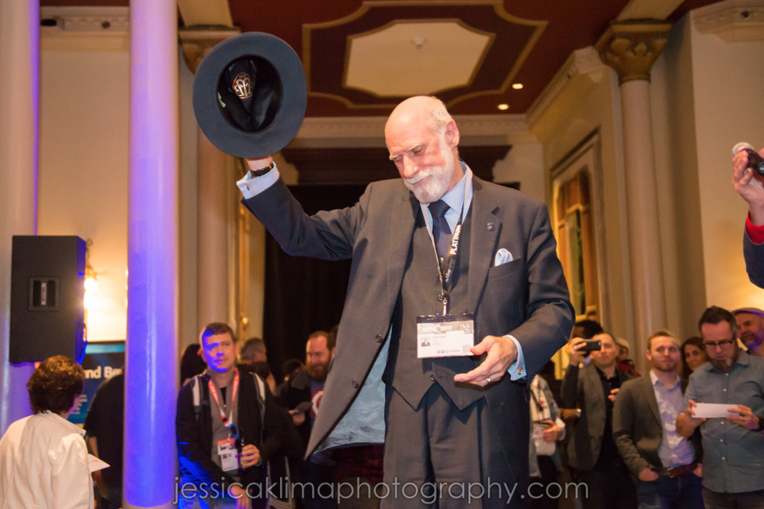
Notes:
Maybe create a slide for each bullet and add one photo
SXSW
Great networking and advertising for future events
FLF
It was a great (rather long) event
Definitely inspirational for young audience
It was good to bring industry veterans to show accomplishments and life in IEEE
It was also great to bring young successful Members to share their more relatable knowledge/experience with the young
Creative networking event that forced people to interact with each other. Made a lot of friends that way
Successful IEEE N3XT in Austin. Over 150 attendees
Strong Young Professionals and Student presence
It had 3 tracks. It was short and sweet
Had a Young Professionals reception right after, which was packed
Drove membership and volunteering opportunities
Lots of students
Started Monthly Networking events
About 15-20 attendees
They all liked the event!
They came to discover volunteering and networking opportunities
They liked the format and the time (Tuesday evening)
Gonna try new sponsors for every monthly event to keep things fresh
To attract newcomers and retain existing audience
Takeaways
To come prepared with contacts amongst other societies for networking
To come prepared with events they can volunteer for
To come prepared with flyers/cards for all the above

Slide 7
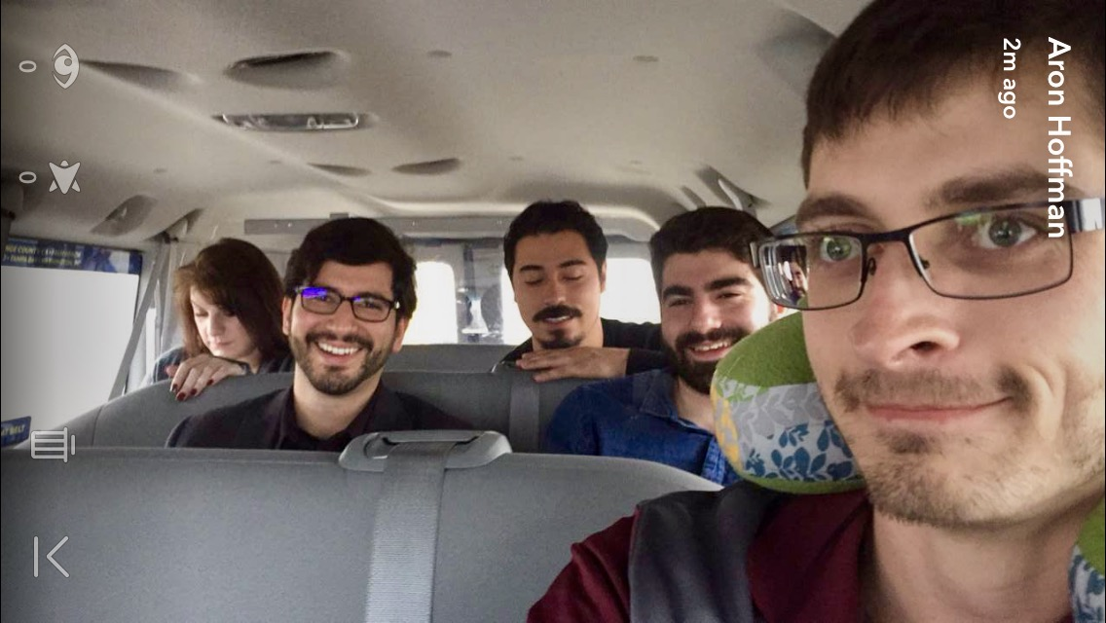
Notes:
Maybe create a slide for each bullet and add one photo
SXSW
Great networking and advertising for future events
FLF
It was a great (rather long) event
Definitely inspirational for young audience
It was good to bring industry veterans to show accomplishments and life in IEEE
It was also great to bring young successful Members to share their more relatable knowledge/experience with the young
Creative networking event that forced people to interact with each other. Made a lot of friends that way
Successful IEEE N3XT in Austin. Over 150 attendees
Strong Young Professionals and Student presence
It had 3 tracks. It was short and sweet
Had a Young Professionals reception right after, which was packed
Drove membership and volunteering opportunities
Lots of students
Started Monthly Networking events
About 15-20 attendees
They all liked the event!
They came to discover volunteering and networking opportunities
They liked the format and the time (Tuesday evening)
Gonna try new sponsors for every monthly event to keep things fresh
To attract newcomers and retain existing audience
Takeaways
To come prepared with contacts amongst other societies for networking
To come prepared with events they can volunteer for
To come prepared with flyers/cards for all the above

Slide 8
Notes:
Maybe create a slide for each bullet and add one photo
SXSW
Great networking and advertising for future events
FLF
It was a great (rather long) event
Definitely inspirational for young audience
It was good to bring industry veterans to show accomplishments and life in IEEE
It was also great to bring young successful Members to share their more relatable knowledge/experience with the young
Creative networking event that forced people to interact with each other. Made a lot of friends that way
Successful IEEE N3XT in Austin. Over 150 attendees
Strong Young Professionals and Student presence
It had 3 tracks. It was short and sweet
Had a Young Professionals reception right after, which was packed
Drove membership and volunteering opportunities
Lots of students
Started Monthly Networking events
About 15-20 attendees
They all liked the event!
They came to discover volunteering and networking opportunities
They liked the format and the time (Tuesday evening)
Gonna try new sponsors for every monthly event to keep things fresh
To attract newcomers and retain existing audience
Takeaways
To come prepared with contacts amongst other societies for networking
To come prepared with events they can volunteer for
To come prepared with flyers/cards for all the above

Slide 9
IEEE Day
Austin
October 3rd
7pm
San Antonio
October 3rd
7pm
Notes:
Maybe create a slide for each bullet and add one photo
SXSW
Great networking and advertising for future events
FLF
It was a great (rather long) event
Definitely inspirational for young audience
It was good to bring industry veterans to show accomplishments and life in IEEE
It was also great to bring young successful Members to share their more relatable knowledge/experience with the young
Creative networking event that forced people to interact with each other. Made a lot of friends that way
Successful IEEE N3XT in Austin. Over 150 attendees
Strong Young Professionals and Student presence
It had 3 tracks. It was short and sweet
Had a Young Professionals reception right after, which was packed
Drove membership and volunteering opportunities
Lots of students
Started Monthly Networking events
About 15-20 attendees
They all liked the event!
They came to discover volunteering and networking opportunities
They liked the format and the time (Tuesday evening)
Gonna try new sponsors for every monthly event to keep things fresh
To attract newcomers and retain existing audience
Takeaways
To come prepared with contacts amongst other societies for networking
To come prepared with events they can volunteer for
To come prepared with flyers/cards for all the above

Slide 10
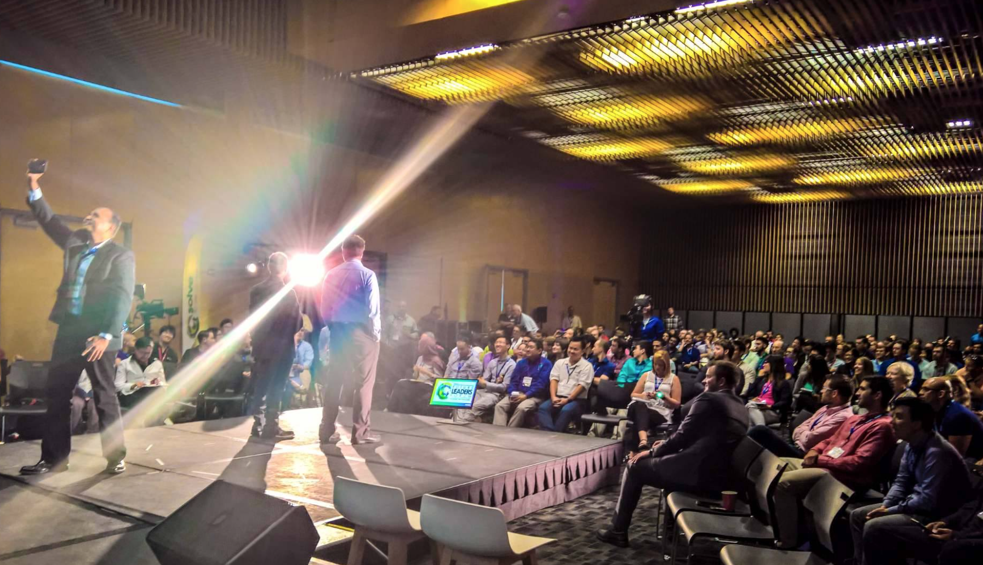
Notes:
Maybe create a slide for each bullet and add one photo
SXSW
Great networking and advertising for future events
FLF
It was a great (rather long) event
Definitely inspirational for young audience
It was good to bring industry veterans to show accomplishments and life in IEEE
It was also great to bring young successful Members to share their more relatable knowledge/experience with the young
Creative networking event that forced people to interact with each other. Made a lot of friends that way
Successful IEEE N3XT in Austin. Over 150 attendees
Strong Young Professionals and Student presence
It had 3 tracks. It was short and sweet
Had a Young Professionals reception right after, which was packed
Drove membership and volunteering opportunities
Lots of students
Started Monthly Networking events
About 15-20 attendees
They all liked the event!
They came to discover volunteering and networking opportunities
They liked the format and the time (Tuesday evening)
Gonna try new sponsors for every monthly event to keep things fresh
To attract newcomers and retain existing audience
Takeaways
To come prepared with contacts amongst other societies for networking
To come prepared with events they can volunteer for
To come prepared with flyers/cards for all the above

Slide 11
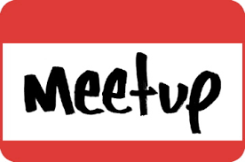
Active Social Following
Notes:
Maybe create a slide for each bullet and add one photo
SXSW
Great networking and advertising for future events
FLF
It was a great (rather long) event
Definitely inspirational for young audience
It was good to bring industry veterans to show accomplishments and life in IEEE
It was also great to bring young successful Members to share their more relatable knowledge/experience with the young
Creative networking event that forced people to interact with each other. Made a lot of friends that way
Successful IEEE N3XT in Austin. Over 150 attendees
Strong Young Professionals and Student presence
It had 3 tracks. It was short and sweet
Had a Young Professionals reception right after, which was packed
Drove membership and volunteering opportunities
Lots of students
Started Monthly Networking events
About 15-20 attendees
They all liked the event!
They came to discover volunteering and networking opportunities
They liked the format and the time (Tuesday evening)
Gonna try new sponsors for every monthly event to keep things fresh
To attract newcomers and retain existing audience
Takeaways
To come prepared with contacts amongst other societies for networking
To come prepared with events they can volunteer for
To come prepared with flyers/cards for all the above

Slide 12
Active Social Following
Including Email
Notes:
Maybe create a slide for each bullet and add one photo
SXSW
Great networking and advertising for future events
FLF
It was a great (rather long) event
Definitely inspirational for young audience
It was good to bring industry veterans to show accomplishments and life in IEEE
It was also great to bring young successful Members to share their more relatable knowledge/experience with the young
Creative networking event that forced people to interact with each other. Made a lot of friends that way
Successful IEEE N3XT in Austin. Over 150 attendees
Strong Young Professionals and Student presence
It had 3 tracks. It was short and sweet
Had a Young Professionals reception right after, which was packed
Drove membership and volunteering opportunities
Lots of students
Started Monthly Networking events
About 15-20 attendees
They all liked the event!
They came to discover volunteering and networking opportunities
They liked the format and the time (Tuesday evening)
Gonna try new sponsors for every monthly event to keep things fresh
To attract newcomers and retain existing audience
Takeaways
To come prepared with contacts amongst other societies for networking
To come prepared with events they can volunteer for
To come prepared with flyers/cards for all the above

Slide 13
2017 Year Summary
IEEE YP Presence in SXSW (2 hot events)
IEEE YP Mimosa Meetup
IEEE Future of Identity After-Party
Fabio attended Region 5 Meeting @NOLA
Ongoing Monthly Networking events
Austin
San Antonio
We have L31s
Collaborated with:
Students
Leadership Reading Group
Humanitarian Project
Grew social media presence (Facebook, Twitter, LinkedIn)
Notes:
Maybe create a slide for each bullet and add one photo
SXSW
Great networking and advertising for future events
FLF
It was a great (rather long) event
Definitely inspirational for young audience
It was good to bring industry veterans to show accomplishments and life in IEEE
It was also great to bring young successful Members to share their more relatable knowledge/experience with the young
Creative networking event that forced people to interact with each other. Made a lot of friends that way
Successful IEEE N3XT in Austin. Over 150 attendees
Strong Young Professionals and Student presence
It had 3 tracks. It was short and sweet
Had a Young Professionals reception right after, which was packed
Drove membership and volunteering opportunities
Lots of students
Started Monthly Networking events
About 15-20 attendees
They all liked the event!
They came to discover volunteering and networking opportunities
They liked the format and the time (Tuesday evening)
Gonna try new sponsors for every monthly event to keep things fresh
To attract newcomers and retain existing audience
Takeaways
To come prepared with contacts amongst other societies for networking
To come prepared with events they can volunteer for
To come prepared with flyers/cards for all the above

Slide 14
Questions
Follow us on:
bit.ly/yp-ctx
bit.ly/yp-ctx-twitter
bit.ly/yp-ctx-linkedin
bit.ly/yp-ctx-slack
bit.ly/yp-ctx-email
@fabiogomez on Slack
fabio.gomez@ieee.org

